Slide 1
Conceptual Framework For Financial Reporting 2018
Assets/Liabilities
(and equity)
Income/Expenses
Recognition
Financial statements

Slide 2
International Financial Reporting Standards (IFRS)

Slide 3
Background to Accounting Standards
Fin Acc 178 – introduction to IFRS statements
Layout
IFRS series: International Financial Reporting Standards
IAS series: International accounting standards
SIC: Standards Interpretations Committee
IFRIC: International Financial Reporting Interpretations Committee
AC500 series: South African interpretations (VAT, BEE)
ED’s: exposure drafts

Slide 4
Background to Accounting Standards
Since 2005:
Compulsory for all SA listed companies to comply with IFRS
Since 2012:
No South African standards any more, only IFRS

Slide 5
Background to Accounting Standards
Format of standards
Objective
Scope
Definitions
Contents of the standard
Disclosure
Transitional provision
Effective date
Statements superseded
Amendments to current statement
Appendices
Basis for conclusion
Implementation guidance
Bold print
– most important sections indicating rules and guidelines

Slide 6
Preface to International Financial Reporting Standards
Preface to statements
Explains the authority held by IFRS & IASB
Approval of IFRS
Objective of IASB:
develop a single set of high quality, understandable standards
Language
The approved text of IFRS = English
Not examinable

Slide 7
CONCEPTUAL FRAMEWORK

Slide 8
Conceptual Framework For Financial Reporting 2018
Status and Purpose
The Conceptual Framework describes the objective of, and the concepts for, general purpose financial reporting.
Conceptual Framework is not a Standard. It does not override Standards or any requirement in a Standard.
Mission of Conceptual Framework is to develop Standards that bring transparency, accountability and efficiency to financial markets around the world.

Slide 9
SCOPE of the framework
The objective of general purpose financial reporting [chap 1]
Qualitative characteristics of useful financial information [chap 2]
Financial statements and the reporting entity [chap 3]
The elements of financial statements [chap 4]
Recognition and derecognition [chap 5]
Measurement [chap 6]
Presentation and disclosure [chap 7]
Concepts of capital and capital maintenance [chap 8]

Slide 10
Objective of general purpose financial reporting Chapter 1

Slide 11
Chapter 1: Introduction [1.1]
The objective of general purpose financial reporting forms the foundation of the Conceptual Framework.
Other aspects logically flow from the objective:
Reporting entity concept
Qualitative characteristics and cost constraints of useful financial information
Elements of financial statements
Recognition and derecognition, measurement, presentation and disclosure

Slide 12
Chapter 1: Objective, usefulness and limitations (1.2–1.11)
OBJECTIVE [1.2]
To provide financial information about the reporting entity that it useful to…
Primary users
Existing and potential investors,
Decisions
Buying / selling / holding equity and debt instruments
Existing and potential lenders, and
Existing and potential other creditors
Providing / settling loans and other forms of credit
Exercising rights to vote on, or otherwise influence, management’s actions that affect the use of the entity’s economic resources
Objective

Slide 13
Chapter 1: Objective, usefulness and limitations (1.2–1.11)
The decisions Depend on expected returns:
Dividends
Principle and interest payments
Market price
providing or settling loans / interest receive/payable [1.3]
Expected returns depend on assessment of the amount, timing and uncertainty of future net cash inflows [1.3]
Assess management stewardship of entity’s economic resources [1.3]

Slide 14
Chapter 1: Objective, usefulness and limitations (1.2–1.11)
Information needed to make these assessments in paragraph 1.3 [1.4]
Economic resources available (Assets)?
How efficiently and effectively the entity’s management have discharged their responsibilities to use entity’s economic resources
Claims against the entity (Liabilities)?

Slide 15
Chapter 1: Objective, usefulness and limitations (1.2–1.11)
Primary users (financial reports are directed to):
existing and potential investors,
lenders and other creditors [1.5]
general purpose financial reports do not and cannot provide all the information that users need. Consider:
- general economic conditions and expectations,
political events and political climate,
Industry outlooks
company outlooks [1.6]
IASB seeks to provide the information set that will meet the needs of the maximum number of primary users. [1.8]

Slide 16
Chapter 1: Objective, usefulness and limitations (1.2–1.11)
General purpose financial reports not designed to show the value of a reporting entity; they provide information to help estimate the value of the reporting entity. [1.7]
Management can use general purpose financial reports .However, management need not rely on general purpose financial reports because it is able to obtain the financial information it needs internally. [1.9]
General purpose financial reports are not directed at regulators and members of the public – but they may also find it useful. [1.10]

Slide 17
Chapter 1: Objective, usefulness and limitations (1.2–1.11)
To a large extent, financial reports are based on estimates, judgements and models rather than exact depictions. The Conceptual Framework establishes the concepts that underlie those estimates, judgements and models. [1.11]

Slide 18
Chapter 1: Economic resources, claims, and changes in resources and claims (1.12-1.21)
General purpose financial reports provide information about the financial position:
economic resources and the claims against the reporting entity and
effects of transactions and events that change a reporting entity’s economic resources and claims [1.12]

Slide 19
Chapter 1: Economic resources, claims, and changes in resources and claims (1.12-1.21)
Information about the nature and amounts of a reporting entity’s economic resources and claims can help identify the strengths and weaknesses.
help users to assess the reporting entity’s liquidity and solvency, its needs for additional financing and how successful it is likely to be in obtaining that financing [1.13]

Slide 20
Chapter 1: Economic resources, claims, and changes in resources and claims (1.12-1.21)
Changes in economic resources and claims result from that entity’s financial performance and from other events or transactions [1.15]
Information about financial performance helps users to understand the return on economic resources, provides an indication of how well management used resources in predicting the entity’s future returns [1.16]

Slide 21
Chapter 1: Economic resources, claims, and changes in resources and claims (1.12-1.21)
Accrual accounting:
- depicts the effects of transactions and other events and circumstances on economic resources and claims in the periods in which those effects occur, even if the resulting cash receipts and payments occur in a different period [1.17-1.19]

Slide 22
Chapter 1: Economic resources, claims, and changes in resources and claims (1.12-1.21)
Previous cash flows indicate financial performance
assess the entity’s ability to generate future net cash inflows.
Indicates
how entity obtains and spends cash
information about its borrowing and repayment of debt,
cash dividends or distributions to investors,
other factors that may affect the entity’s liquidity or solvency.
help users
- understand entity’s operations
- evaluate its financing and investing activities [1.20]
Economic resources and claims may change for reasons other than financial performance (eg. Issue of shares) [1.21]

Slide 23
Qualitative characteristics of useful information Chapter 2

Slide 24
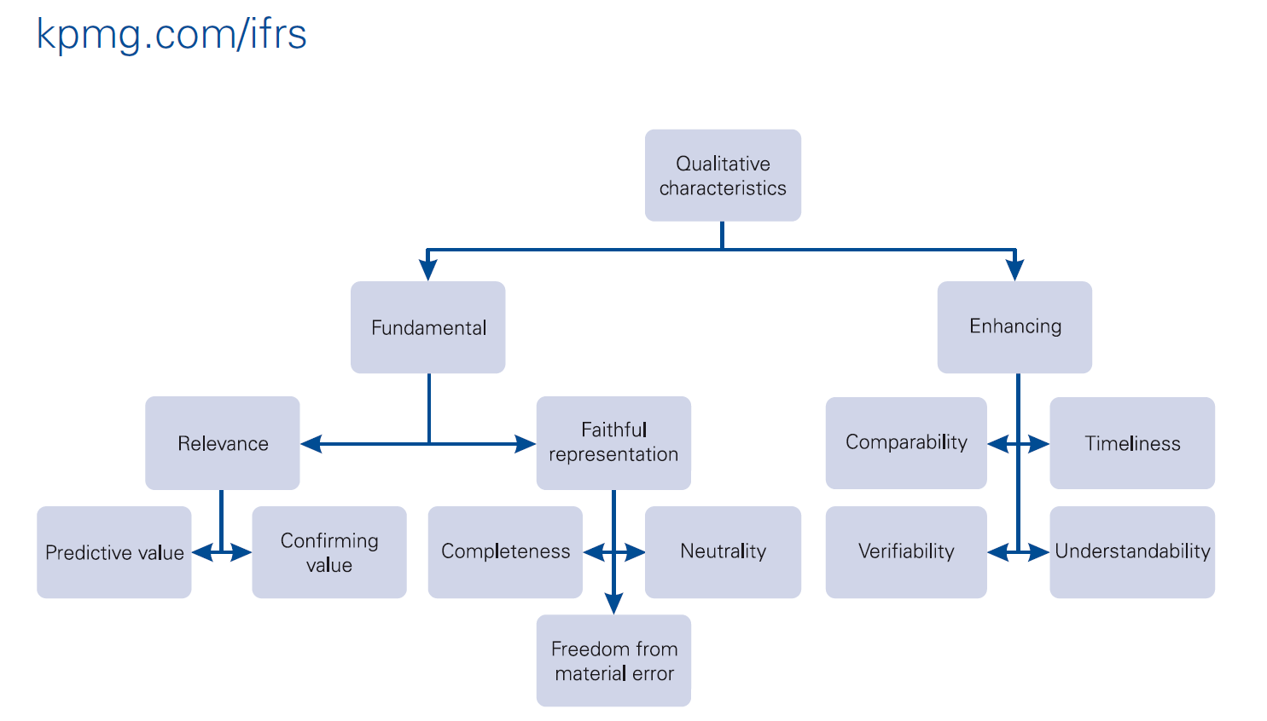
Chapter 2: Qualitative characteristics of useful financial information (2.1-2.43)

Slide 25
Chapter 2: Qualitative characteristics of useful financial information (2.1-2.43)
Characteristics of information in Fin. Statements that are likely to be most useful to users [2.1-2.3]

Slide 26
Chapter 2: Qualitative characteristics of useful financial information (2.1-2.43)
FUNDAMENTAL CHARACTERISTICS
(Primary/minimum requirements for useful information -> need to meet both (2.4)
Relevant
Faithful representation

Slide 27
Chapter 2: Qualitative characteristics of useful financial information (2.1-2.43)
RELEVANT
(Can influence users’ economic decisions)
Predictive value
(can be used as an input to processes employed by users to predict future outcomes)
Confirmatory value
(provides feedback about (confirms or changes) previous evaluations)
Materiality [2.11]
Information is material if omitting it or misstating it could influence decisions that users make on the basis of financial information about a specific reporting entity (entity-specific).

Slide 28
Chapter 2: Qualitative characteristics of useful financial information (2.1-2.43)
FAITHFUL REPRESENTATION
(Faithfully represent economic phenomena)
Completeness
(all necessary info)
Neutral
(impartial)
Free from error
(description and process to produce info)

Slide 29
Chapter 2: Qualitative characteristics of useful financial information (2.1-2.43)
Information must be both relevant and faithfully represented if it is to be useful. [2.20]
Process for applying
Identify an economic phenomenon that has the potential to be useful to users of the reporting entity’s financial information
Identify the type of information about that phenomenon that would be most relevant if it is available and can be faithfully represented.
Determine whether that information is available and can be faithfully represented. [2.21]

Slide 30
Chapter 2: Qualitative characteristics of useful financial information (2.1-2.43)
ENHANCING CHARACTERISTICS
(Secondary – not primary requirement)
Comparability
Verifiability
Timeliness
Understandability

Slide 31
Chapter 2: Qualitative characteristics of useful financial information (2.1-2.43)
Enhancing qualitative characteristics:
Comparability: [2.24-2.29]
Information is useful if it is comparable with other entities, or similar information of the same entity for another period or another date.
Don’t confuse with uniformity; uniformity helps to achieve comparability
Verifiability: [2.30-2.32]
Verifiability helps assure users that information faithfully represents the economic phenomena it purports to represent. It means that different knowledgeable and independent observers could reach consensus.
Verification can be direct (observation: by counting cash) or indirect (checking the inputs formula and recalculating the outputs)

Slide 32
Chapter 2: Qualitative characteristics of useful financial information (2.1-2.43)
Timeliness [2.33]
having information available to decision-makers in time to be capable of influencing their decisions.
Understandability [2.34-2.36]
- Classifying, characterising and presenting information clearly and concisely makes it understandable.
- Include inherently complex information, otherwise reports will be incomplete and potentially misleading.
- Financial reports are prepared for users who have a reasonable knowledge of business and economic activities and who review and analyse the information diligently. May need help from advisers.

Slide 33
Chapter 2: Qualitative characteristics of useful financial information (2.1-2.43)
Applying the enhancing qualitative characteristics [2.37-2.38]
- Enhancing qualitative characteristics, cannot make information useful if it is irrelevant or not faithfully represented.
Applying the enhancing qualitative characteristics is an iterative process.
The cost constraint on useful financial reporting [2.39-2.43]
- Important that costs are justified by the benefits of reporting that information.
- Users bear the cost of collecting, processing, verifying and disseminating financial information (costs in the form of reduced returns).
- Reporting financial information that is relevant and faithfully represented helps users to make decisions with more confidence.

Slide 34
Financial statements and the reporting entity Chapter 3

Slide 35
Chapter 3: Financial statements and the reporting entity (3.1-3.18)
Chapter 1 – 2: Discuss information provided in general purpose financial reports
Chapter 3 – 8: Discuss information provided in general purpose financial statements [3.1]
Objective and scope of financial statements [3.2-3.3]
to provide financial information about the assets, liabilities, equity, income and expenses…
This information is provided in:
Statement of financial position
Statement of financial performance (statement of comprehensive income for Fin Acc 178)
Other statements

Slide 36
Chapter 3: Financial statements and the reporting entity (3.1-3.18)
Reporting period [3.4-3.7]
Financial statements are prepared for a specified period of time [3.4]
To help users identify, assess changes and trends. Also provide comparative information for at least 1 period.
Information about possible future transactions and events
Information about transactions and other events that have occurred after year end, if the information is necessary.
Perspective adopted financial statements [3.8]
Provide information about transactions, other events viewed from perspective of reporting entity as a whole – not from perspective of any particular group of entity’s investors, lenders, creditors.
Going concern [3.9]
FS prepared on assumption of going concern, continue in operation for foreseeable future.

Slide 37
Chapter 3: Financial statements and the reporting entity (3.1-3.18)
The reporting entity [3.10-3.18]
Required, or chooses, to prepare FS. Can be singe entity / portion of entity / more than one entity.
Not necessarily a legal entity
Consolidated financial statements / unconsolidated financial statements / combined financial statements [3.11-3.12]
Determining the boundary of a reporting entity can be difficult [3.13-3.14]
Consolidated and unconsolidated financial statements [3.15-3.18]

Slide 38
The elements of financial statements Chapter 4

Slide 39
Chapter 4: The elements of financial statements [4.1-4.72]
Elements of financial statements:
assets, liabilities and equity, which relate to reporting entity’s financial position; and
Income and expenses, which relate to reporting entity’s financial performance (Statement of comprehensive income) [4.1]

Slide 40
Chapter 4: The elements of financial statements [4.1-4.72]
Definition of an asset [4.3-4.25]
An asset is a present economic resource
Controlled by the entity
As a result of past events [4.3]
An economic resource is a right
That has the potential to produce economic benefits [4.4]

Slide 41
Chapter 4: The elements of financial statements [4.1-4.72]
Control[4.19-4.25]
present ability to direct the use of the economic resource and obtain the economic benefits that may flow from it, including preventing other parties from directing the use of the economic resource and from obtaining the economic benefits that may flow from it.
usually arises from an ability to enforce legal rights.

Slide 42
Chapter 4: The elements of financial statements [4.1-4.72]
Definition of a liability [4.26-4.47]
A liability is a present obligation of the entity
To transfer an economic resource
As a result of past events [4.26]

Slide 43
Chapter 4: The elements of financial statements [4.1-4.72]
Definition of equity [4.63-4.67]
Equity is the residual interest in the assets of an entity after deducting all its liabilities [4.63]

Slide 44
Chapter 4: The elements of financial statements [4.1-4.72]
Definitions of income and expenses [4.68-4.72]
Income [4.68]
Income is increases in assets
Or decreases in liabilities
That results in increases in equity, other than those relating to contributions from holders of equity claims.
Expenses [4.69]
Expenses are decreases in assets
Or increases in liabilities
That results in decreases in equity, other than those relating to distributions to holders of equity claims.

Slide 45
Recognition and derecognition Chapter 5

Slide 46
Chapter 5 – Recognition and derecognition [5.1-5.33]
Recognition is the process of capturing for inclusion in SFP or Statement of comprehensive income
An item that meets the definition of one of the elements – asset, liability, equity, income, expense.
Recognition involves depicting the item in one of those statements – either alone or in aggregation with other items – in words and by a monetary amount, and including that amount in one or more totals in that statement.
Amount at which asset, liability, equity recognized in SFP = carrying amount [5.1]

Slide 47
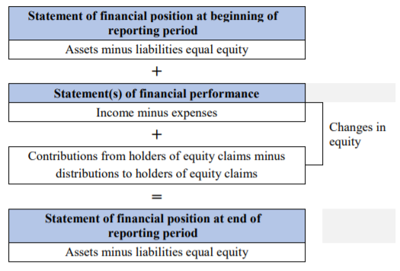
Chapter 5 – Recognition and derecognition [5.1-5.33]
How recognition links the elements of financial statements

Slide 48
Chapter 5 – Recognition and derecognition [5.1-5.33]
Simultaneous recognition
Initial recognition of assets/liabilities arising from transactions or other events may result in simultaneous recognition of both income and related expenses.
Simultaneous recognition also referred to as the matching of costs with income.
However, not an objective of the Conceptual Framework.

Slide 49
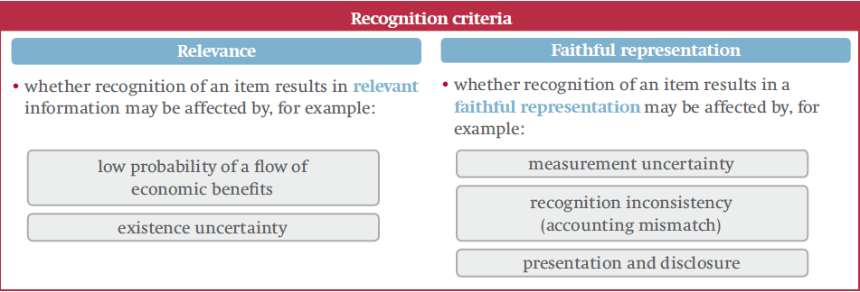
Chapter 5 – Recognition and derecognition [5.1-5.33]
Recognition criteria [5.6 – 5.25]

Slide 50
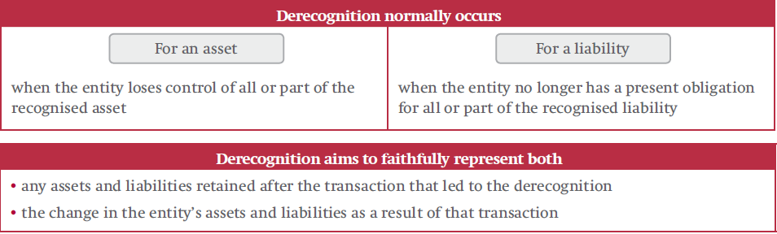
Chapter 5 – Recognition and derecognition [5.1-5.33]
Derecognition [5.26-5.33]

Slide 51
Measurement Chapter 6

Slide 52
Chapter 6: Measurement [6.1-6.95]
Measurement bases [6.4-6.22]
Historical cost [6.4-6.9]
Current value [6.10-6.22]
Fair value
Value in use and fulfilment value
Current cost

Slide 53
Chapter 6: Measurement [6.1-6.95]
Factors to consider when selecting a measurement basis [6.43-6.86]
In most cases, no single factor will determine which measurement basis should be selected. Depend on facts and circumstances [6.44]

Slide 54
Chapter 6: Measurement [6.1-6.95]
Measurement of equity [6.87-6.90]
Total carrying amount of equity is not measured directly.
It may be appropriate to measure directly the carrying amount of some individual classes of equity and some components of equity

Slide 55
Presentation and disclosure Chapter 7

Slide 56
Chapter 7: Presentation and disclosure [7.1-7.20]
A reporting entity communicates information about its assets, liabilities, equity, income and expenses by presenting and disclosing information in its financial statements [7.1]
Effective communication makes information more relevant and contributes to a faithful representation of an entity’s A,L,E,I,E. It also enhances the understandability and comparability.

Slide 57
Chapter 7: Presentation and disclosure [7.1-7.20]
Classification
Classifying dissimilar A,L,E,I,E together can obscure relevant information, reduce understandability and comparability [7.8]
Classification of assets and liabilities
Is applied to the unit of account selected for an asset or liability. However, sometimes appropriate to separate an asset or liability in components that have different characteristics [7.9]
Offsetting
Classifies dissimilar items together and therefore is generally not appropriate. Different from treating a set of rights and obligations as a single unit of account [7.10-7.11]

Slide 58
Chapter 7: Presentation and disclosure [7.1-7.20]
Classification of equity
May be necessary to classify equity claims separately if those equity claims have different characteristics / subject to particular legal, regulatory or other requirements [7.12-7.13]
Classification of income and expenses
Applied to income and expenses from the unit of account selected for an asset or liability, or components of such income and expenses if it has different characteristics and are identified separately.

Slide 59
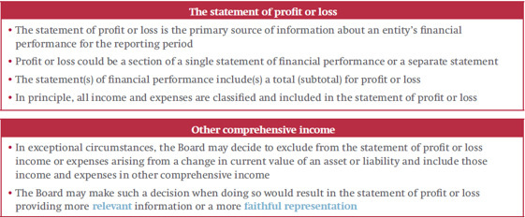
Chapter 7: Presentation and disclosure [7.1-7.20]
Profit or loss and other comprehensive income (SCI)

Slide 60
Chapter 7: Presentation and disclosure [7.1-7.20]
Aggregation
Adding together A,L,E,I,E that have shared characteristics and included in same classification.
Makes information more useful
However, conceals some of the detail. Therefore, find balance [7.20-7.22]

Slide 61
Concepts of capital and capital maintenance Chapter 8

Slide 62
Chapter 8: Concepts of capital and capital maintenance [8.1-8.10]
Capital
Financial concept of capital = net assets or net equity of the entity
Physical concept of capital = productive capacity of the entity (e.g. production units per day)
Capital maintenance
Financial capital maintenance
Profit is earned only if financial/monetary amount of net assets at the end of a period > beginning of the period (excluding distributions/contributions of equity participants)
Physical capital maintenance
Profit is earned only if physical production capacity of the entity at the end of the period > beginning of the period (excluding distributions/contributions of equity participants
If entity has same capital at the beginning and end of a period – capital has been maintained (any amounts > or < is profit or loss)

Slide 63
Chapter 8: Concepts of capital and capital maintenance [8.1-8.10]
NB:
Increases in prices of assets is therefore a profit, but may not be recognised as profit until the assets are disposed of in an exchange transactions – therefore recognised in reserves

Slide 64
Chapter 8: Concepts of capital and capital maintenance [8.1-8.10]
Capital maintenance adjustments
Revaluation of assets results in increase/decrease in equity
Therefore, meets the definition of income/expenses
But are not disclosed in the statement of comprehensive income due to the concept of capital maintenance (profit not realized)
Disclosed instead as revaluation surplus within equity

